Slide 1
BURN

Slide 2
French Revolution (1789): human rights and democratic government were considered a universal goal
French revolutionaries did not consider slavery a pressing problem
Economic importance of the colonies

Slide 3
Black slaves organized a large-scale in St. Domingue (1791)
Spain, Great Britain, and France sent troops against the rebels but they were defeated
In 1804 the republic of Haiti was proclaimed
Europeans countries boycotted the new state causing great economic damage to Haiti.

Slide 4
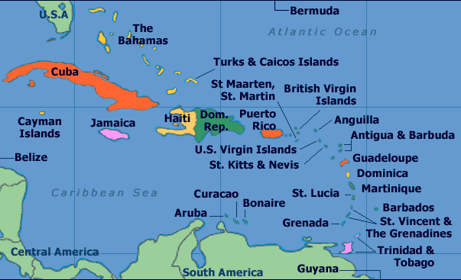

Slide 5
During the 19th century, Great Britain supported the movements for independence in Latin America
It did not only wish to undermine Spanish and Portuguese colonial empire, but it also wanted the possibility to acquire cheap raw materials and acquire new markets for its industrial products.

Slide 6
Great Britain also exported large capitals to the Latin American countries, by investing vast sums of money in their economies
In this way Great Britain established and informal “empire of trade” in Latin America and assigned the Latin American countries a dependent position

Slide 7
Instead of producing goods themselves and selling them within their own markets, the Latin American countries became suppliers of raw materials for British industry and, at the same time, became more dependent upon British products.
During the 20th century, the US took the place of Great Britain in Latin America
The same process occurred in former European colonies in Africa and Asia after WWII

